Slide 1
Air Traffic Control Simulation
Instruction Guide: You may follow at your own pace

Slide 2
Air Traffic Control Simulator
Welcome to the Air Traffic Control Simulator Experiment. In this experiment you will complete a task that is similar to the popular mobile game, “Flight Control”.
Before we start, you will be presented with a brief training presentation. Then throughout a series of trials, it will be your job to keep an air traffic control sector operating safely. The entire experiment will last approximately 150 minutes.
Please turn off your mobile phones before clicking to continue.

Slide 3
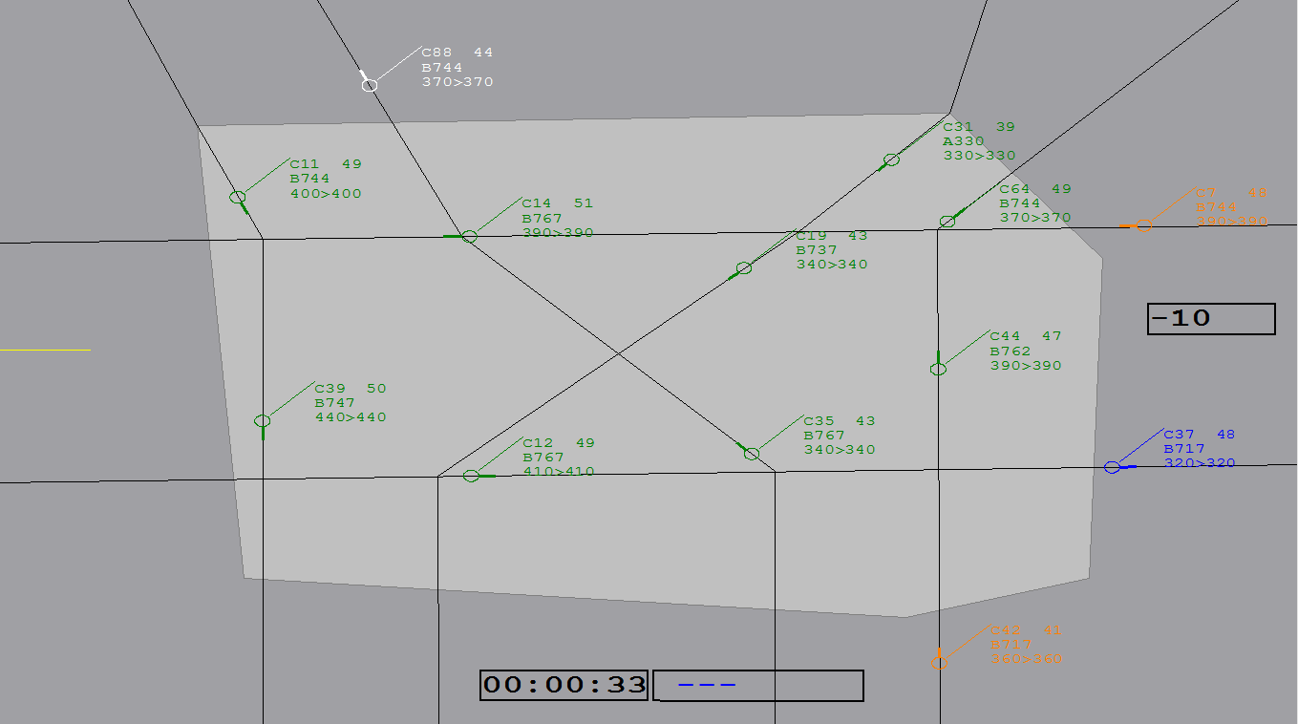
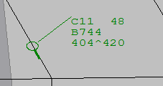

Click to Continue
Click to Start
Notes:
This light grey polygon is your air control sector. It is your goal to safely manage aircraft entering this area, leaving this area, flying within this area.
Aircraft are represented as green circles with a line attached. The line indicates which direction the aircraft is travelling in. In this example, this aircraft is travelling down, this aircraft is travelling to the right, and this aircraft is travelling down also.
Aircraft also have an attached information box which contains four important elements. (1) This text here tells you the the unqiue callsign or name of the aircraft. (2) This text tells you the speed at which the aircraft is travelling in nautical miles per hour. Simply remember that a larger number means the aircraft is travelling faster. Therefore, it will go a further distance on the display over time. (3) This text tells you the kind of aircraft it is. (4) This box is the most important. It tells you the current altitude that the aircraft is travelling at, and the altitude it may be changing to. If both numbers are the same, the aircraft is at cruising altitude, meaning it is not changing. However, if the aircraft is ascending or descending altitude, it will look like this. As you can see, the two numbers are different, with the first number indicating the current altitude, and the second number indicating the altitude the aircraft is climbing to. The arrow in between the numbers indicates whether the aircraft is ascending or decending.

Slide 4
Please inform the experimenter that this segment is complete

